Slide 1
İSTANBUL OKAN ÜNİVERSİTESİ OPAE Okan Proficiency Academic Exams in English
Okan University Department of Foreign Languages

Slide 2
WHAT IS OPAE EXAM?
OPAE English Proficiency Exam is a proficiency exam for students enrolling for the first time in English-medium programmes at OKAN University.
The ONLINE test measures reading, writing, listening and speaking skills in English at B2 (CEFR) level.
Those who are considered as successful proceed to their department while those who fail continue the one-year compulsory preparatory class.
Okan University Department of Foreign Languages

Slide 3
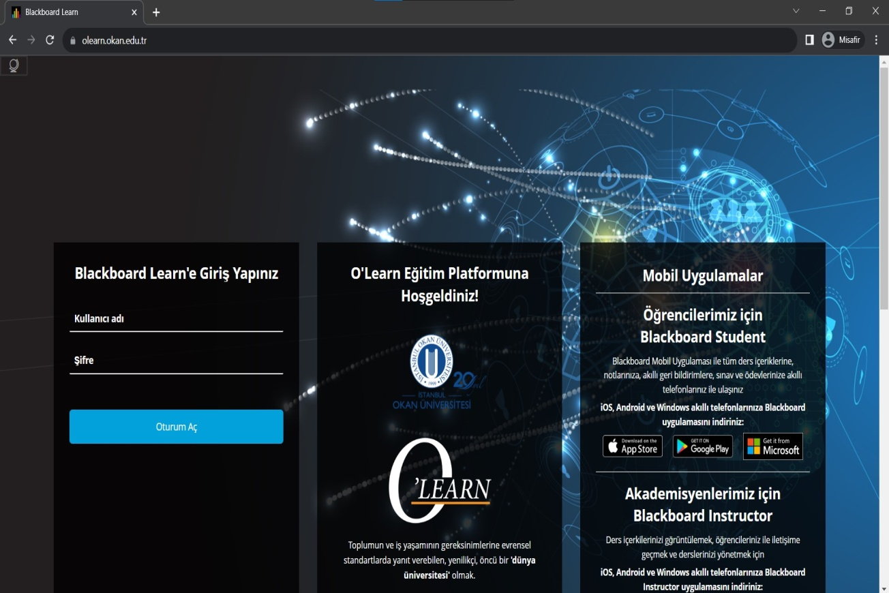
HOW DO THE STUDENTS TAKE THE EXAM?
OPAE is a fully online exam.
The exam is conducted with the camera and microphone open. Those who violate the rule are not allowed to take the exam.
The student logs in to the BLACKBOARD O'LEARN system using their Okan ID and password from https://olearn.okan.edu.tr.
Okan University Department of Foreign Languages

Slide 4
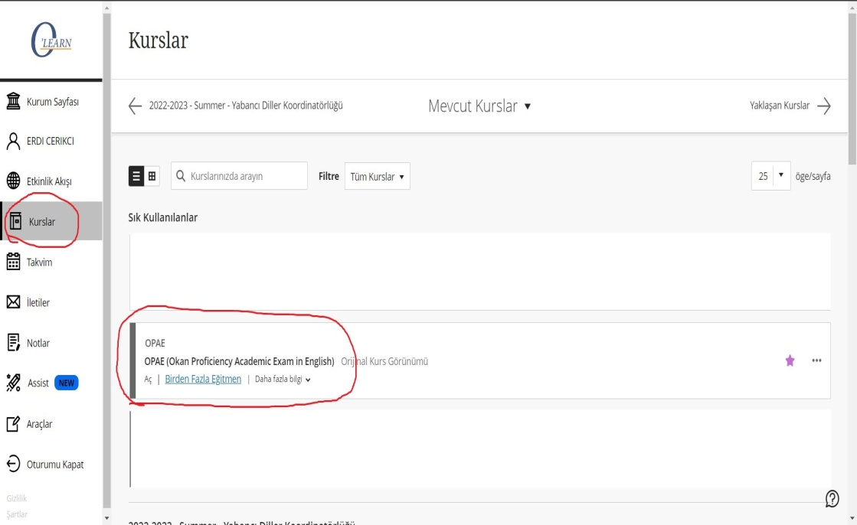
HOW DO THE STUDENTS TAKE THE EXAM?
The student is presented with the virtual classroom page where the OPAE exam will be given.
Click on the "Courses" tab in the left menu to display the exam screen on the relevant page.
Okan University Department of Foreign Languages

Slide 5
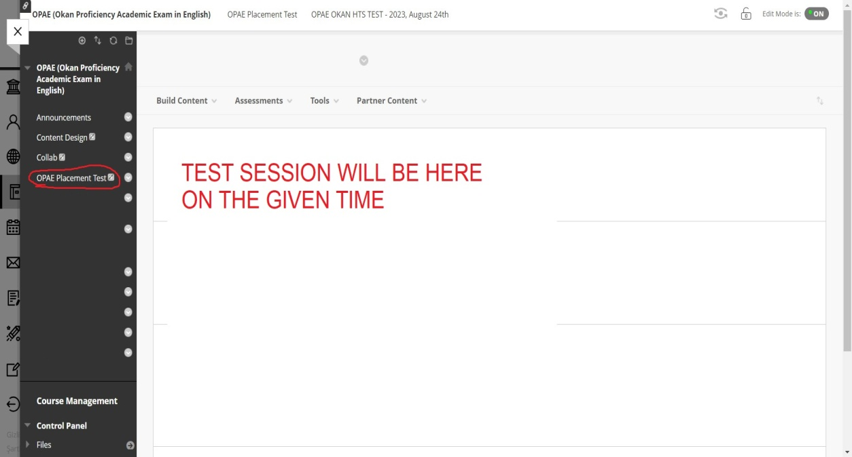
OPAE: 1) Test Session
There are two sessions of this exam:
1. Test Session
Use of English,Reading,Writing,Listening
2. Speaking Session
They will be able to view the Reading, Listening, Use of English and Writing sections of the test at the announced time by clicking on the OPAE Proficiency Test tab from the left menu.
Okan University Department of Foreign Languages

Slide 6
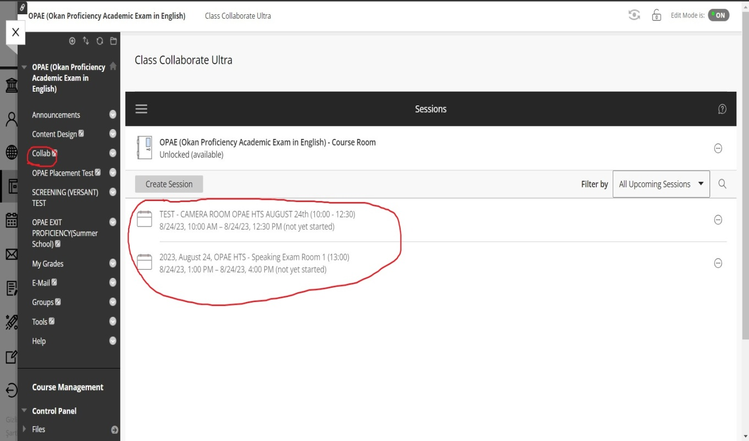
OPAE: 2) Speaking Session
The speaking session is held in the virtual classroom, which is accessed by clicking on the "Collab" tab in the left menu.
Okan University Department of Foreign Languages

Slide 7
Let's take a closer look at the OPAE exam!
The exam consists of questions on five different skills, distributed over two sessions:
Test session
Reading
Listening
Use of English
Writing
Speaking session
Speaking
Okan University Department of Foreign Languages

Slide 8
1. READING
The reading section of the OPAE Entrance exam consists of one or two texts. There are 20 multiple choice questions in total. The duration of the reading section is 1 hour. A sample reading question is as follows:
Sample question: According to the text, why is the knowledge of traditional Samoan medicine in danger of being lost?
a) Because young Samoan women are no longer interested in learning the art of healing from their mothers.
b) Because the plants used in traditional Samoan medicine are becoming extinct due to human activity.
c) Because Western medicine is more effective than traditional Samoan medicine.
d) Because the use of traditional Samoan medicine is prohibited by law.
Okan University Department of Foreign Languages

Slide 9
2. LISTENING
The listening section of the OPAE exam consists of a part of a lesson. There are 10 multiple choice questions in total. The duration of the listening section is 30 minutes. A sample listening question:
Sample question: According to the lecture, what is the possible link between genes and Alzheimer's disease?
a) Having specific genes will definitely cause Alzheimer's.
b) Genetic mutations can increase the risk of developing Alzheimer's.
c) Alzheimer's disease is not related to genetics at all.
d) Genes can prevent Alzheimer's if they are healthy.
Okan University Department of Foreign Languages

Slide 10
3. USE OF ENGLISH
The Use of English section of the OPAE test consists of 20 multiple-choice questions that measure grammar and vocabulary skills. The duration of this section is 30 minutes. Sample question:
Sample question: She experienced a sense of __________ when she achieved her lifelong dream of becoming an astronaut.
a) apprehension
b) trepidation
c) euphoria
d) disillusionment
Okan University Department of Foreign Languages

Slide 11
4. WRITING
The Writing section of the OPAE consists of an essay using 250-300 words. The duration is 30 minutes.
Sample question:
Prompt: Some people believe that violence on television and in computer games damages society. Others deny that these factors have no significant influence on people's behavior.
Topic: Write a paragraph expressing your opinion on whether violence on TV and in computer games affects society by damaging or whether it does not create any significant influence on people's behavior. Considering TV and computer games' effects on people, please write a 250-300-word essay providing evidence to support your argument, also with examples from your personal experiences if necessary.
Okan University Department of Foreign Languages

Slide 12
5. SPEAKING
The Speaking section of the OPAE Entrance exam consists of a series of questions lasting approximately 10 minutes. A sample speaking question is as follows:
Sample question: Discuss the impact of urbanization on the environment and human well-being. What measures can be taken to create sustainable and livable cities?
Okan University Department of Foreign Languages

Slide 13
☺ Wishing you success ☺
Okan University Department of Foreign Languages

